Slide 1
CHAPTER 7 & 8 BONDING

Slide 2
Atoms and their Electrons
Valence Electrons – the outer most electrons that are
involved in bonding
Ex.
Ion – an atom or group of atoms that has a positive or
negative charge
Cation – an ion with a positive charge (Na⁺ or Mg²⁺)
– usually a metal that has lost e⁻
Anion – an ion with a negative charge (Cl⁻ or O²⁻)
– usually a non-metal that has gained e⁻

Slide 3
Chemical Bonding
Chemical Bond – an attraction between the nuclei and the outer most electrons of different atoms that results in binding them together
3 Major Classifications
I. Ionic Bond
II. Covalent Bond
- Polar
- Nonpolar
III. Metallic Bond
Notes:
*

Slide 4
Ionic vs. Covalent Compounds
The melting points, boiling points, and hardness of
compounds are dependent upon how strongly basic units
are attracted to each other.
Ionic – greater forces of attraction (+ and -)
– higher melting points
– higher boiling points
– greater hardness
– brittle (shift causes repulsion)
– conduct electricity in solution (ions move freely)
Covalent – weaker forces of attraction
– lower melting points
– lower boiling points
– softer
Metallic – strong bonds
– ductile (drawn, pulled, extruded to produce wire)
– malleable (hammered or beaten into thin sheets)

Slide 5
Ionic Bond - resulting from an electrostatic attraction between positive and negative ions.
Metals lose e¯ and nonmetals gain e¯
One atom gives up e¯ to the other
Covalent Bond – resulting from the sharing of e⁻ between two atoms.
Polar: unequal attraction (sharing) of e¯
Nonpolar: equal attraction (sharing) of e¯
Metallic Bond – e¯ are free to roam through material (“sea of electrons”)

Slide 6
The Octet Rule
chemical compounds tend to form so that each atom, by gaining, losing, or sharing electrons, has an octet of electrons in its highest occupied energy level
(exceptions – H and He)
Notes:
*

Slide 7
The electronegativity (attraction for an electron)
of atoms can be used to predict the type of bond
that will form.
Bond Type | Electronegativity Difference | Typically
Ionic | Large (2.0+) | Metal + Nonmetal
Covalent (Polar) | Medium (0.4-2.0) | Nonmetal + Nonmetal
Covalent (Nonpolar) | Small (0-0.4) | Nonmetal + Nonmetal
Metallic | Not Applicable | Metals

Slide 8
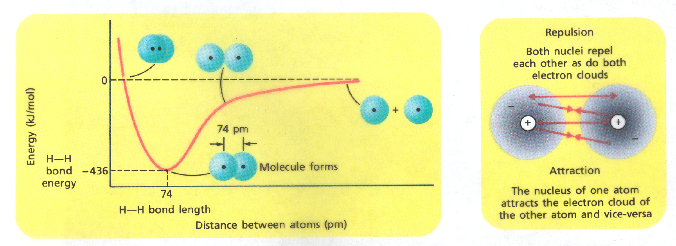
Formation of Ionic Bonds
Ionic bonds are formed when there is a transfer of electrons:
lose e¯ => form (+) ions
gain e¯ => form (-) ions
Formation of Covalent Bonds
Covalent bonds are formed when electrons are
shared and cause atoms to be at a lower potential energy:

Slide 9
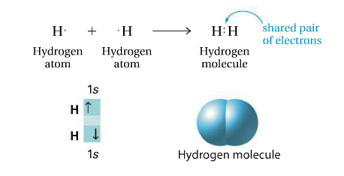
Single Covalent Bonds – Two atoms held together by sharing a pair of electrons
Structural Formula: represents covalent bonds by dashes and shows the arrangement of covalently bonded atoms
Notes:
*

Slide 10
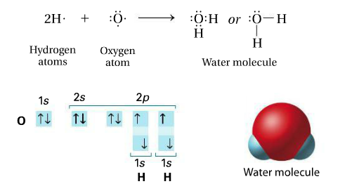
A pair of valence electrons that is not shared between atoms is called an unshared pair, also known as a lone pair. These can be identified from the structural formula (as seen below)
Notes:
*

Slide 11
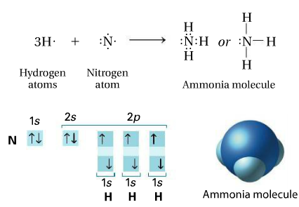
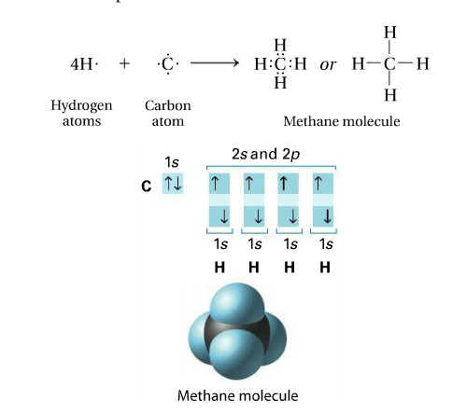
How many lone pairs do the following have?
Notes:
*

Slide 12
Lewis Dot Example: ICl
1. Determine the electronegativities of each
atom and predict the bond type.
3.16 – 2.66 = 0.5 (polar covalent)
**THIS STEP WILL BE USED LATER**
2. Draw the Lewis structure for each atom.
3. Determine the total number of valence
electrons.
I = 1 x 7e¯ = 7e¯
Cl = 1 x 7e¯ = 7e¯
14e¯

Slide 13
4. Arrange the atoms into a skeletal
structure and connect atoms by e¯.
- least electronegative atom in middle
- if C is present, place in the middle
- H is normally around the outside
5. Add e¯ to give each atom (except H, He)
an octet (8e¯)
6. Count electrons and double check against
#3.

Slide 14
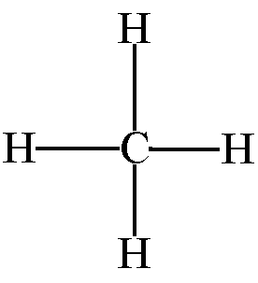
Practice with structural formulas… Try these:
Cl₂ HBr CH₄

Slide 15
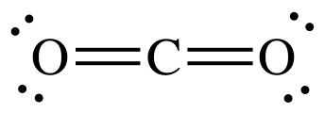
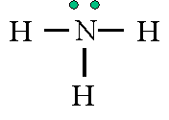
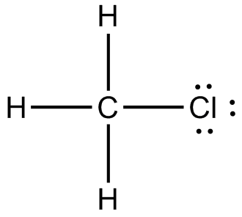
Practice with structural formulas with 3+ atoms… *Note: The lowest electronegative atom USUALLY goes in the middle, & Hydrogen is always around the outside
NH₃ H₂O CH₃Cl CO₂

Slide 16
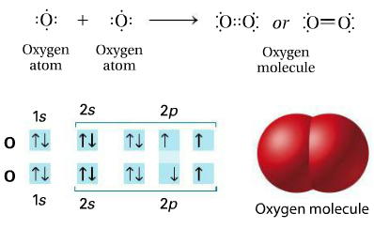
Double covalent bonds are when atoms share two pairs of electrons to attain a noble gas structure
Notes:
*

Slide 17
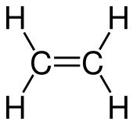
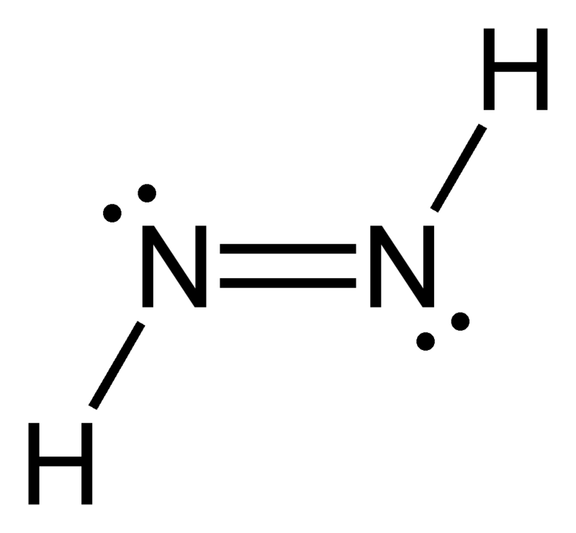
Practice with structural formulas… Try these:
C₂H₄ N₂H₂ N₂

Slide 18
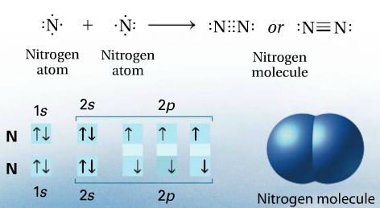
Triple bonds are when atoms share three pairs of electrons to attain a noble gas structure
**NOTE: There are no quadruple bonds, due to the way electrons repel each other**
Notes:
*

Slide 19
Bond Length & Bond Strength
1. Single Bond – longest bond (weakest)
Ex. ICl
2. Double Bond – shorter bond (stronger)
Ex. CH₂O
3. Triple Bond – shortest bond (strongest)
Ex. HCN

Slide 20
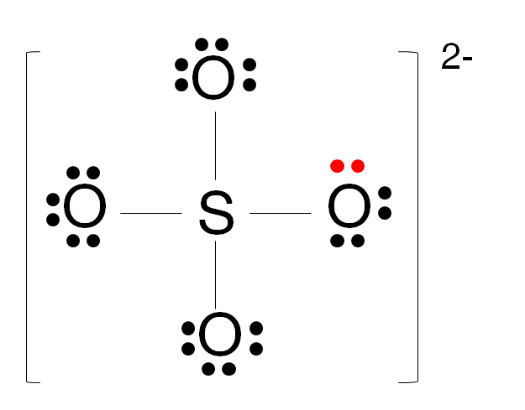
Polyatomic Ions
The charge tells you if you are gaining or losing electrons.
(+) => losing e¯
(-) => gaining e¯
Same process… just account for your addition or subtraction of electrons
For example: NH₄⁺ SO₄²⁻

Slide 21
VSEPR Theory
(Valence-Shell, Electron Pair Repulsion)
The repulsion between electron pairs causes molecular shapes to adjust so that the valence-electron pairs stay as far apart as possible.
Basically. . . Electron pairs repel each other, and so they want to be as far apart from each other as possible
*Lone pairs occupy space around the central atom just as bonding pairs do. In fact, they repel even more than bonding pairs*

Slide 22
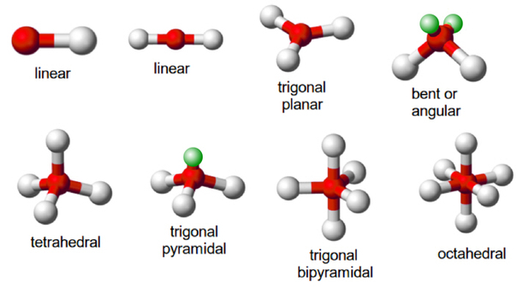
Molecular Geometry
3-D arrangement of a molecule’s atoms in space
*While lone pair electrons contribute to the overall shape of the molecule, really only the atoms determine the shape*

Slide 23
A word on determining shapes. . .
Look at the number of bonds around the central atom (double & triple count as only one), each group of electrons must be accommodated around the central atom. They must be as far away from each other as possible.
Formula | # of Bonds | # lone pairs | Bonding Angle | Shape
CO₂ | 2 | 0 | 180 | Linear
BF₃ | 3 | 0 | 120 | Trigonal Planar
CH₄ | 4 | 0 | 109.5 | Tetrahedral
NH₃ | 3 | 1 | 107 | Pyramidal
H₂O | 2 | 2 | 105 | Bent

Slide 24
Determining Molecular Polarity
First you must determine if any bonds are polar. A polar bond is a covalent bond in which the electrons are shared unequally.

Slide 25
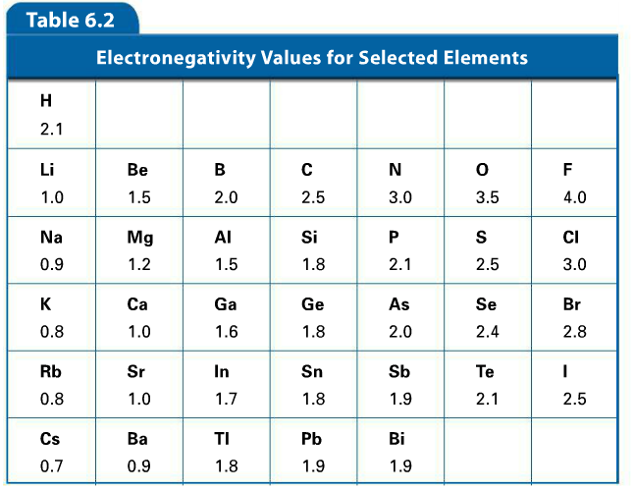

Slide 26
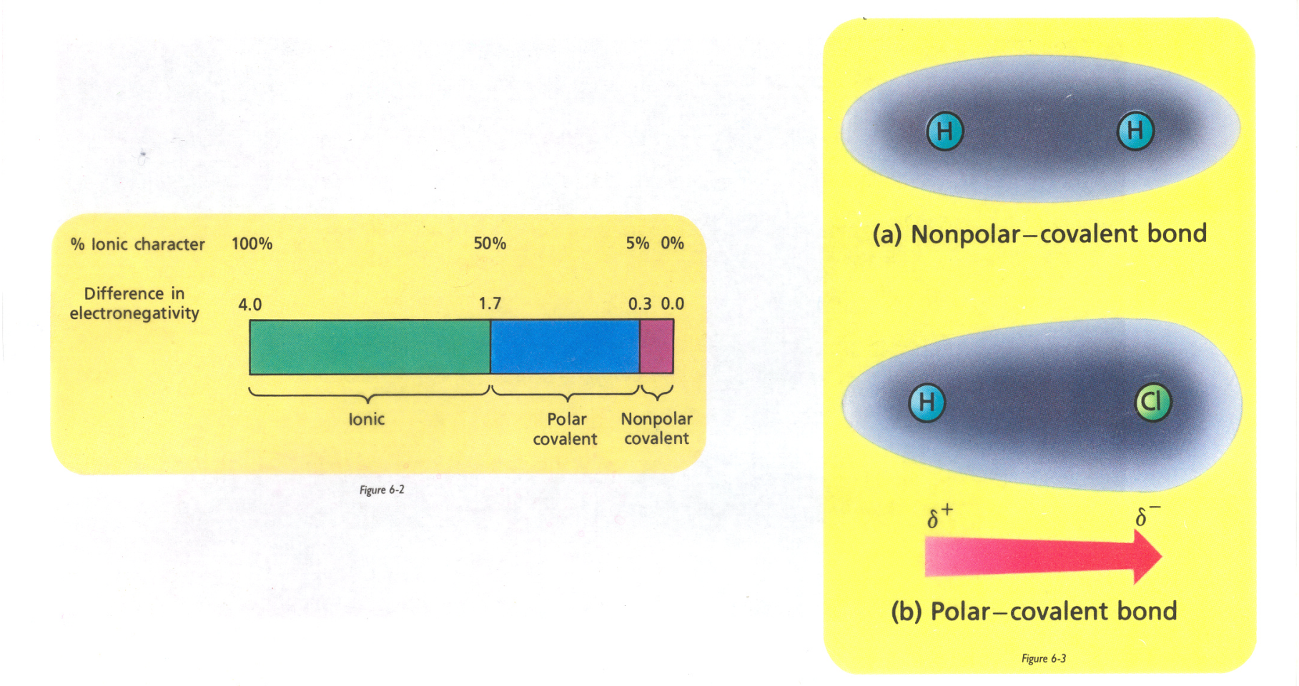
The more electronegative atom attracts electrons more strongly and gains a slightly negative charge. The less electronegative atom gains a slightly positive charge
Page 237 of book

Slide 27
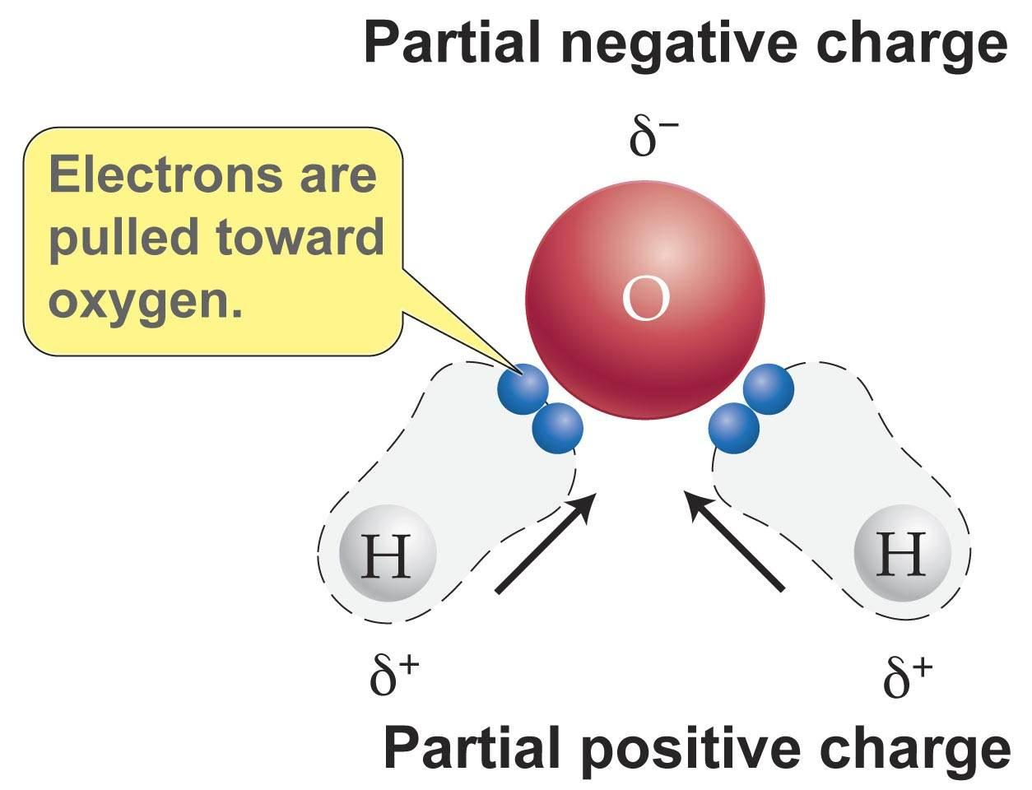
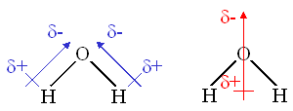
PROOF?...

Slide 28
Determining Molecular Polarity
A polar molecule is a molecule where one end is slightly negative and the other is slightly positive. These two differently charged ends give the molecule a dipole.
USE SYMMETRY
Molecule | Lone Pairs or Polar Bonds? | Symmetry? | Polar? NonPolar? Ionic?
Cl₂ | Lone Pairs | Yes | Nonpolar
RbBr | N/A | No | Ionic
HBr | Both | No | Polar
H₂O | Both | No | Polar
CH₄ | Polar Bonds | Yes | Nonpolar
CO₂ | Both | Yes | NonPolar
C₂H₄ | Polar Bonds | Yes | NonPolar

Slide 29
Lewis Dot Example: ICl
1. Determine the electronegativities of each
atom and predict the bond type.
3.16 – 2.66 = 0.5 (polar covalent)
2. Draw the Lewis structure for each atom.
3. Determine the total number of valence
electrons.
I = 1 x 7e¯ = 7e¯
Cl = 1 x 7e¯ = 7e¯
14e¯

Slide 30
4. Arrange the atoms into a skeletal
structure and connect atoms by e¯.
- least electronegative atom in middle
- if C is present, place in the middle
- H is normally around the outside
5. Add e¯ to give each atom (except H, He)
an octet (8e¯)
6. Count electrons and double check against
#3.
7. Determine molecular polarity based on bond types, lone pairs, and symmetry

Slide 31
Intermolecular Forces
– Forces of attraction between molecules
Weak forces
Van der Waals Forces:
1) Dipole-Dipole forces
2) London Dispersion forces
Stronger forces
Hydrogen Bonds

Slide 32
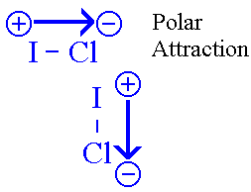
Dipole – Dipole Forces
– attraction between polar molecules
“Dipole” created by a difference in electronegativity
– Ex.

Slide 33
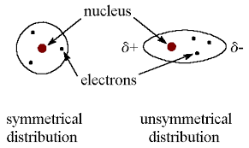
London Dispersion Forces
– attraction resulting from constant motion of electrons
and the creation of an instantaneous dipole

Slide 34
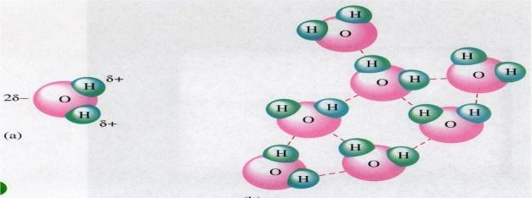
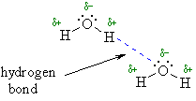
Hydrogen Bonding
– attraction between Hydrogen (+) and a strong
electronegative atom such as F, O, N with lone pair electrons
– Ex.

